Slide 1

Individual linguistic variability in social media
https://bilder2.n-tv.de/img/incoming/origs21986841/7122798858-w0-h0/127838060.jpg
Tatjana Scheffler
September 14, 2023, CMC Corpora
Notes:
Which discourse phenomena show variant vs. stable expression across different media/registers?
How do individual language users adapt to the communicative situation / medium?
What can we learn about a language user through their linguistic expressions?

Slide 2


Medium

Slide 3
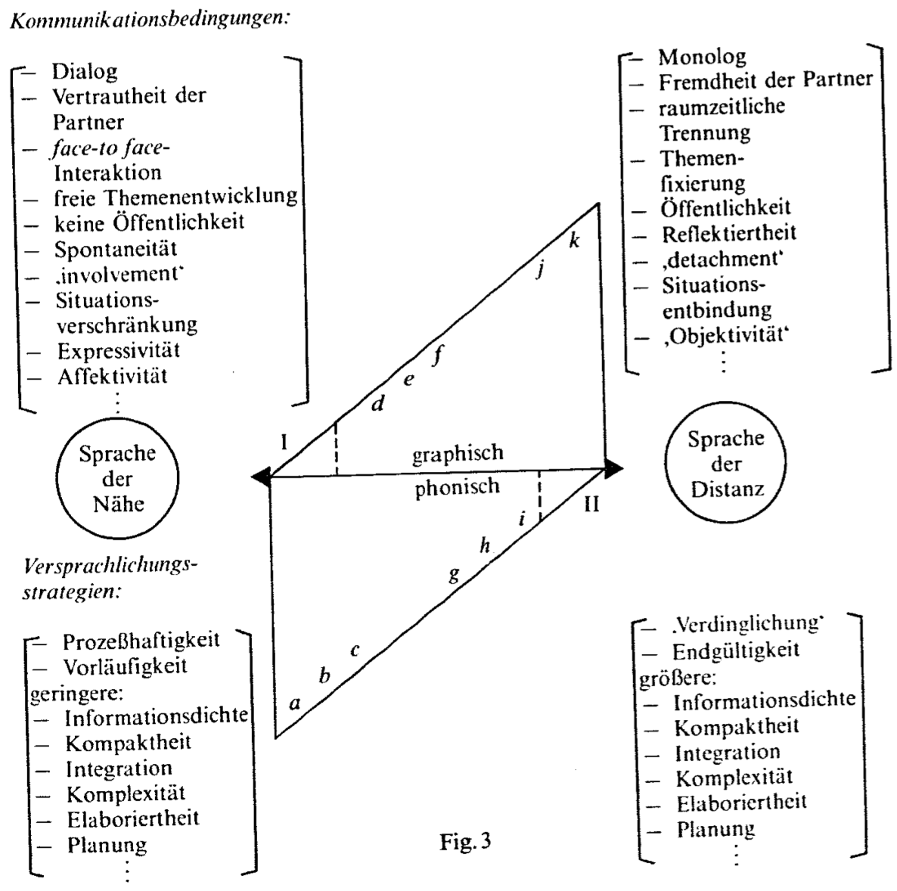
Written
Distant
Close
Spoken
Koch/Österreicher (1985)
Notes:
Social media = informal language in written form
mixed settings, communities
technical constraints

Slide 4
Differences between (social) media
Conceptual orality continuum (Koch/Oesterreicher, 1985)
No single parameter distinguishes between “spoken” and “written” language, many features/dimensions need to be considered (Biber, 1993)
Social media (text messages) exhibit a mix of innovative or speech-like and conservative (written-like) features (Tagliamonte/Denis, 2008)
non-standard features, personal pronouns
intensifiers
mix of innovative and conservative variants, often in the same turn/sentence
conceptually oral conceptually written
Notes:
Teens’ speech vs. text messaging

Slide 5
Non-standard items
(1) So excited for CMC-Corpora 🤗
(2) SO EXCITED FOR CMC-CORPORA!
(3) Soooooo excited for CMC-Corpora!
(4) So excited for CMC-Corpora *freu*

Slide 6
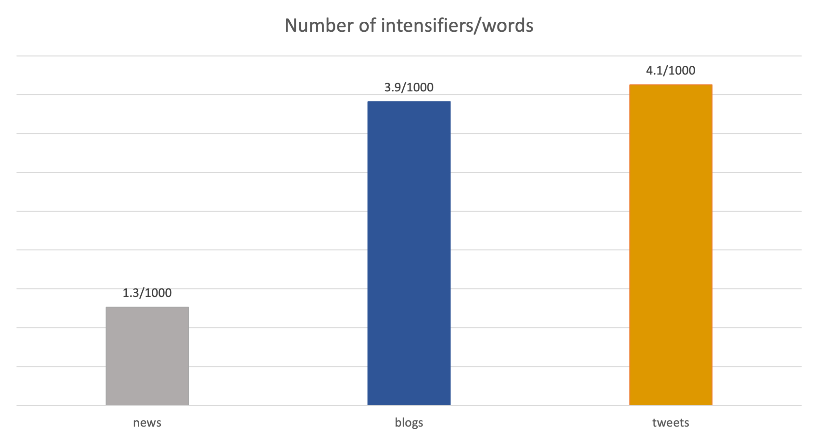
Intensifiers

Slide 7
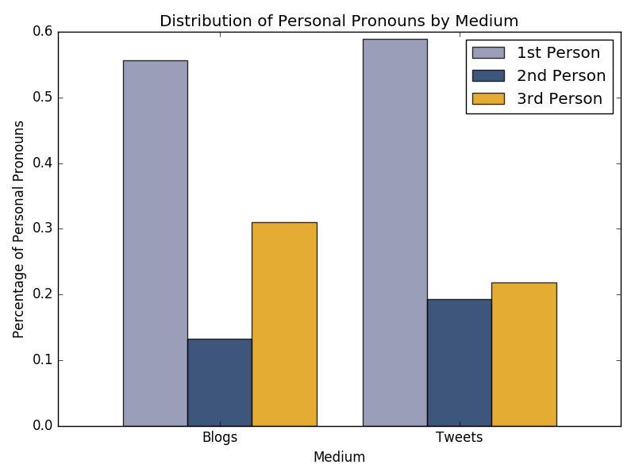
Personal pronouns
Potsdam Commentary Corpus (German news): 88% third person pronouns
Twitter / blogs:

Slide 8
Bl
Blogs
Tweets
Written
Distant
Close
Spoken
Koch/Österreicher (1985)
Notes:
Social media = informal language in written form
mixed settings, communities
technical constraints
Few studies that specifically compare different channels and fewer that look at individual speakers across channels

Slide 9






Individual
Topic
Medium
Register
Notes:
Few studies that specifically compare different channels and fewer that look at individual speakers across channels

Slide 10




Constructing CMC Corpora

Slide 11
CMC Corpora
Principles:
Sustainable
Ethical
Open

Slide 12
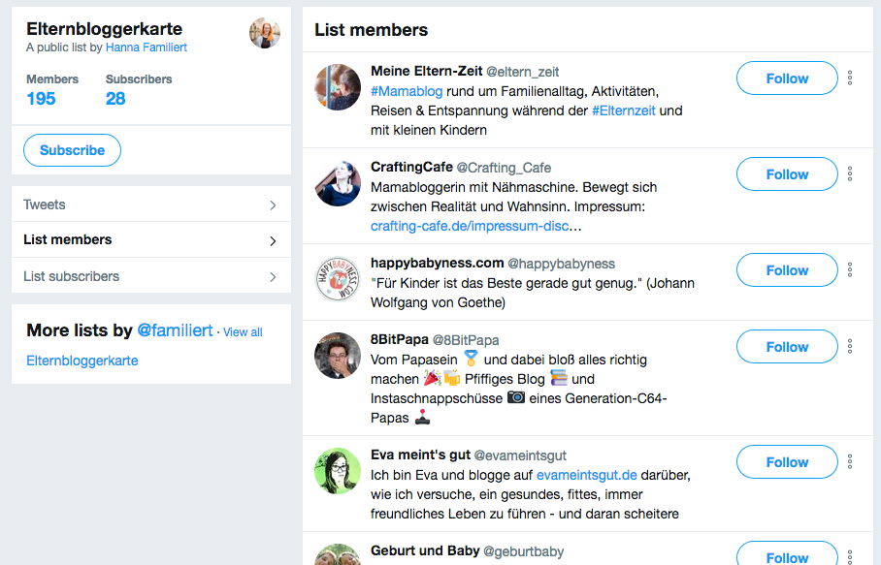
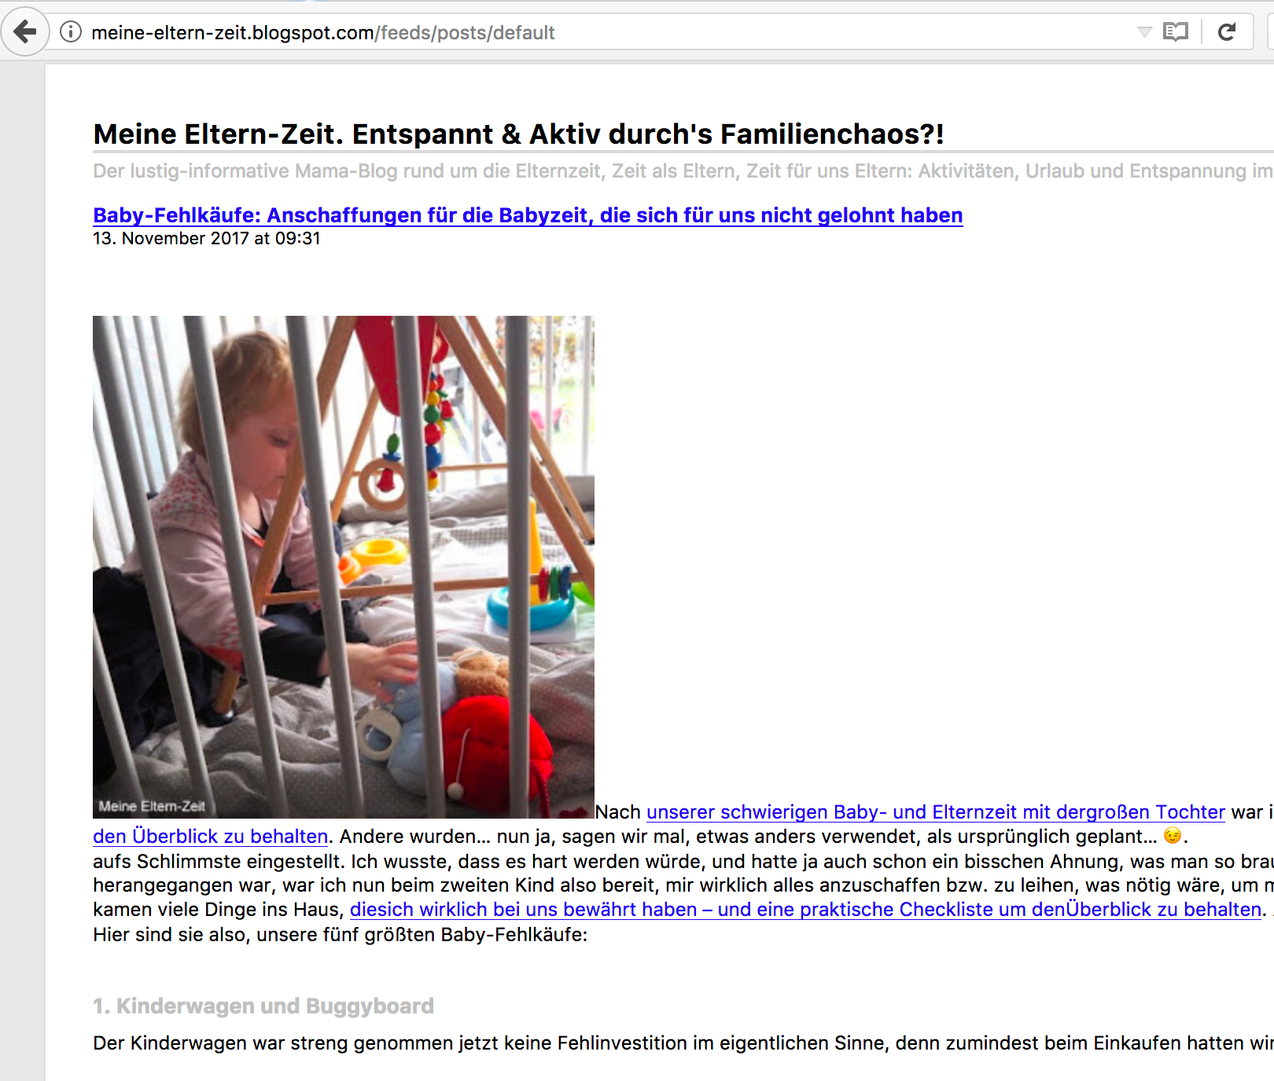
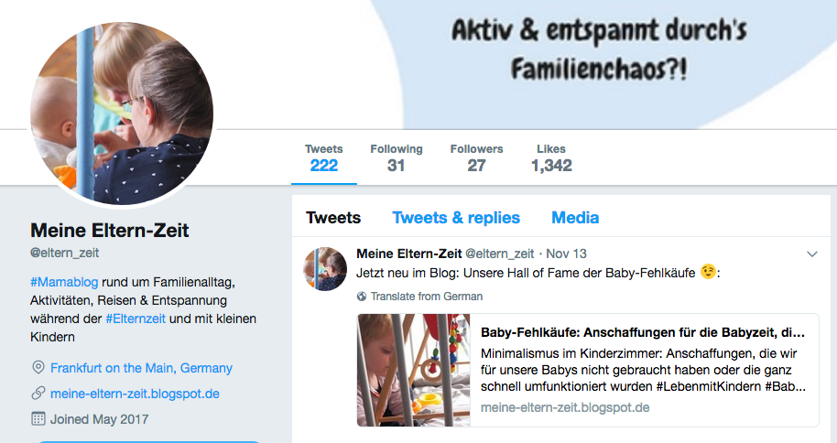
Creating a cross-channel corpus

Slide 13
Privacy
Collection of data follows §60d UrhG
Informing authors, give option to withdraw consent (Opt-Out)
62 authors, 50 could be contacted:
3 refusals, 41 agree, 6 agree after answering questions
Manual Pseudonymization
personal name, blog name, email, place, @username, url, phone number
„Plowed sidewalks!
In Mannheim they flatten the
snow cover and then they spread gravel (or whatever it's called) over it like crazy.“
„Plowed sidewalks!
In [PLACE] they flatten the
snow cover and then they spread gravel (or whatever it's called) over it like crazy.“
Notes:
Ersetzen von persönlichen Angaben durch Platzhalter, Vergabe von anonyme IDs
Personen der Öffentlichkeit nicht anonymisiert
Gastartikel komplett gelöscht

Slide 14

TwiBloCoP
Twitter and Blog Corpus – Parenting
http://tiny.cc/twiblocop
Collection period: Oct. 2016–Feb. 2017
Topics: Family life and parenting
Raw text, tokenized, TEI XML format
 | blog posts | tweets
users | 44 | 44
posts | 468 | 81,440
tokens | ~360,000 | ~1,200,000
Notes:
Ttr over first 1000 tokens per user
5–10 blog posts, up to 3000 tweets for each user

Slide 15
TwiBloCoP
‘Children are our mirrors. If you want to change your child, change YOUR behavior, not the child’s. My son has these tantrums all the time. Regularly. Then it is very difficult to get him out of it. And that is exactly what I would like to do. […] Hm. At some point I asked myself why these fits upset me so much.’ [blog-4421-10]
Alarm rang every 5 minutes since 6 am. Got up right before 8. Great. Worked like a charm🙈 [tweets-7291]

Slide 16
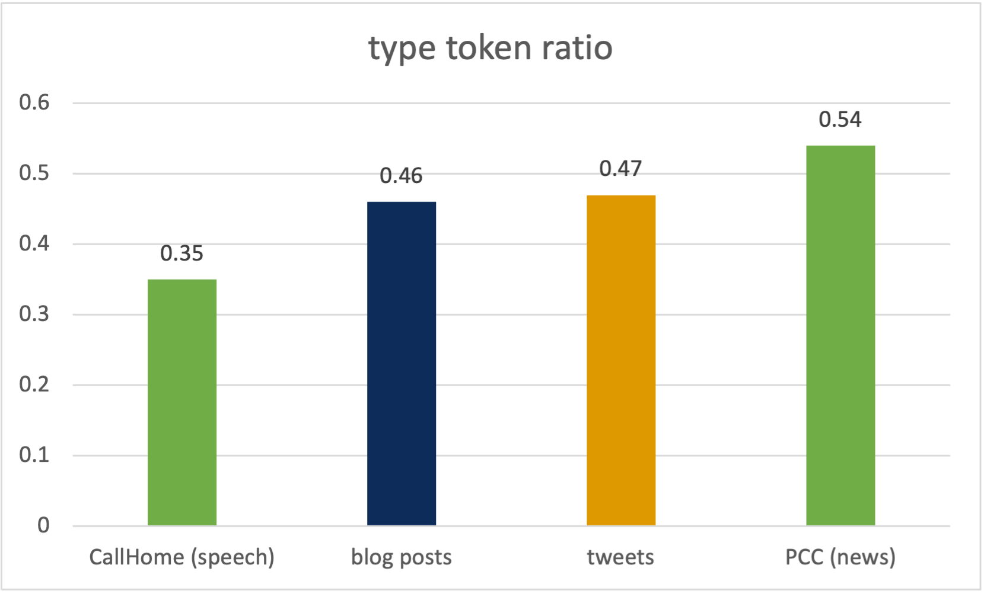
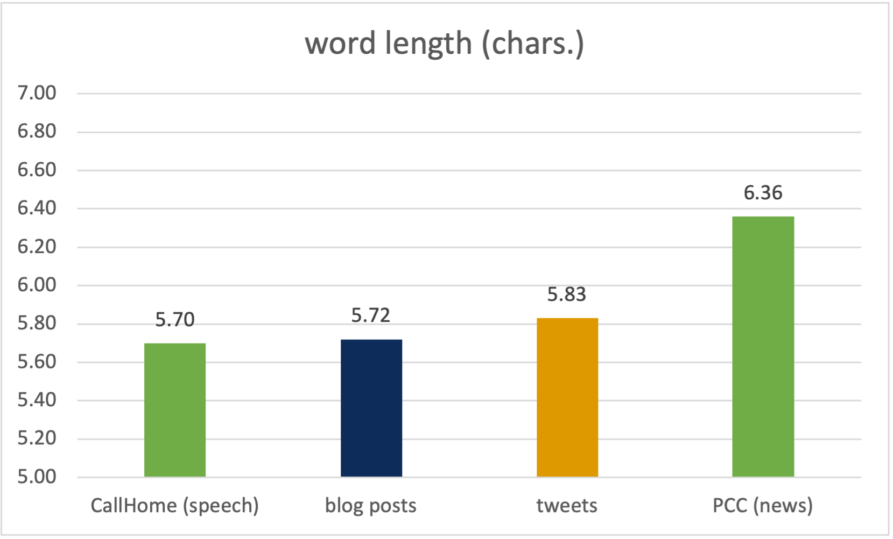
Characteristics of CMC data
Distinct from typical speech and writing, but can share features of either
In measures of complexity, (in)formality both blogs/Twitter differ from (news) text
But Twitter more interactive, and contains “innovative” social-media specific features

Slide 17
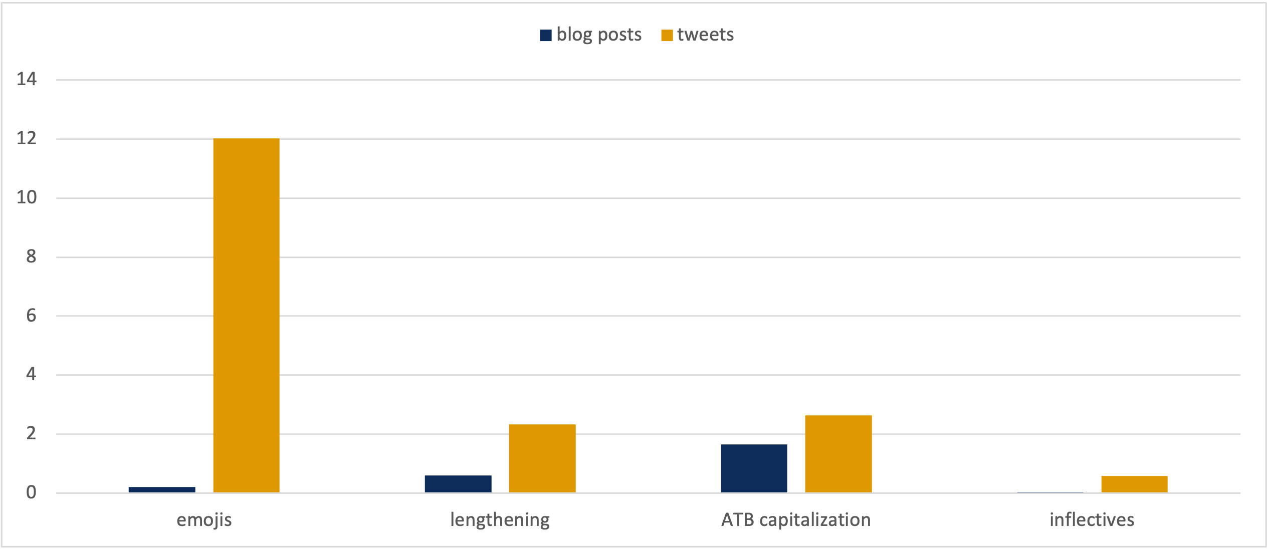
Non-standard items
Frequencies per 1000 tokens:
(1) So excited for CMC-Corpora 🤗
(2) SO EXCITED FOR CMC-CORPORA!
(3) Soooooo excited for CMC-Corpora!
(4) So excited for CMC-Corpora *freu*
Notes:
Per 1000 tokens

Slide 18
Individual
Topic
Medium
Register
Notes:
Question: Orderly Heterogeneity? Do all people within the corpus behave the same?

Slide 19
Individual variation

Slide 20
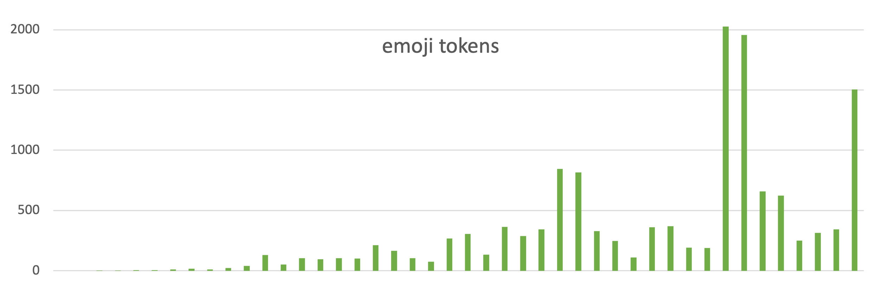
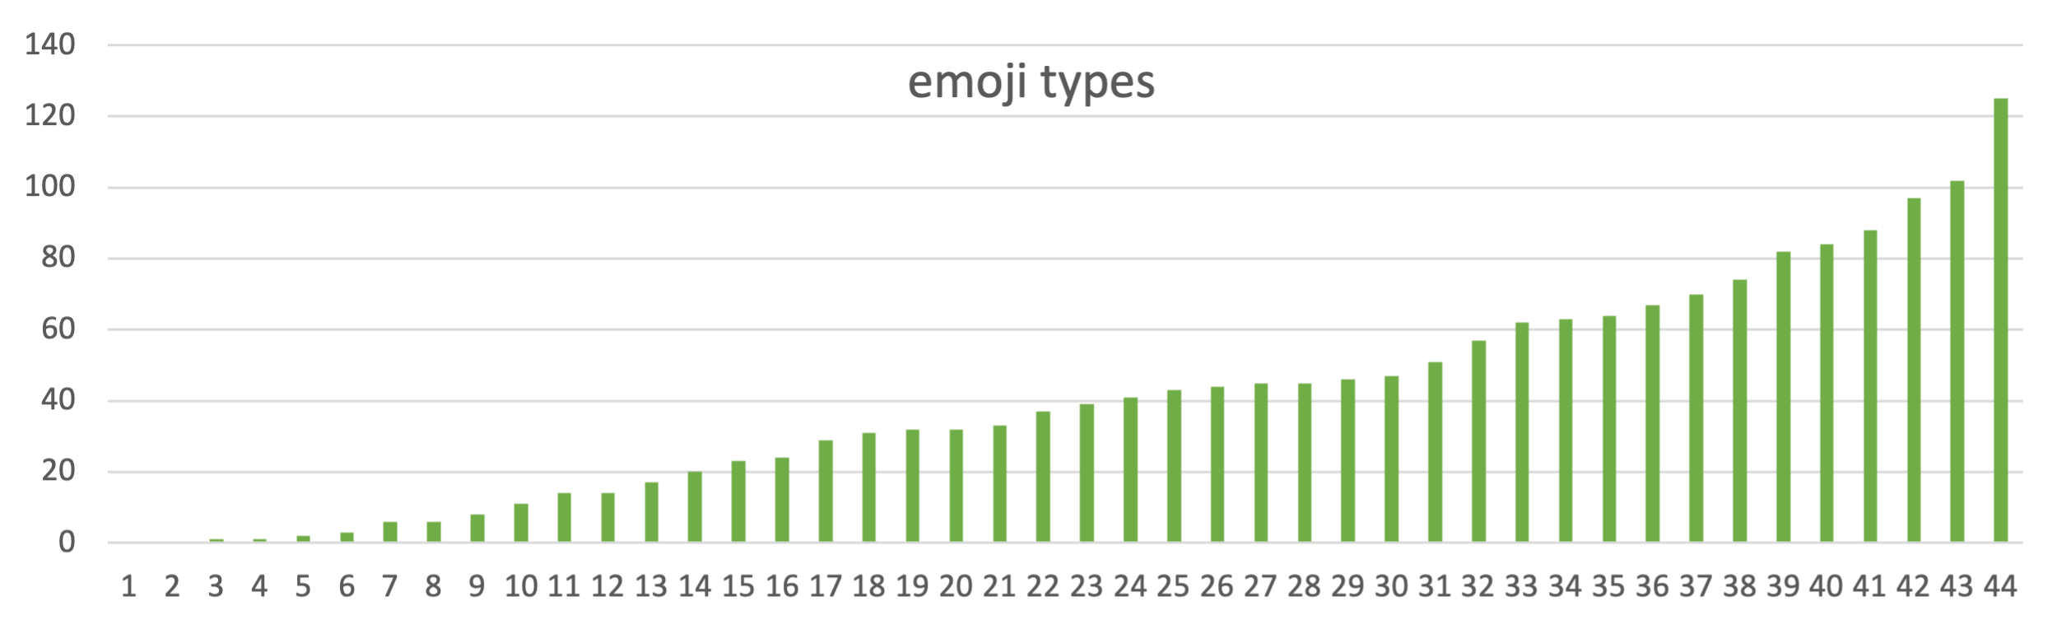
Individual variation in emoji usage

Slide 21
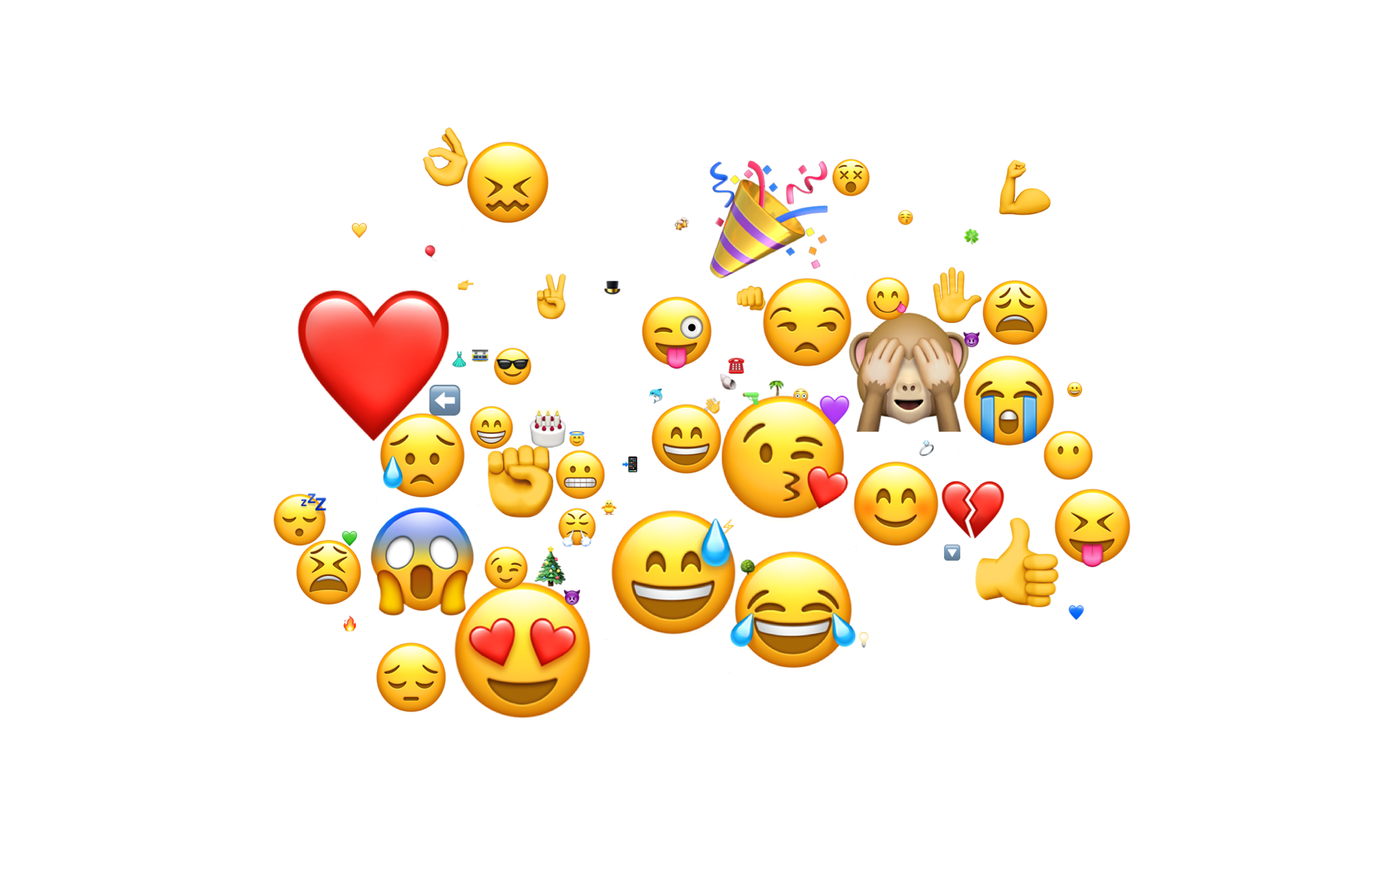
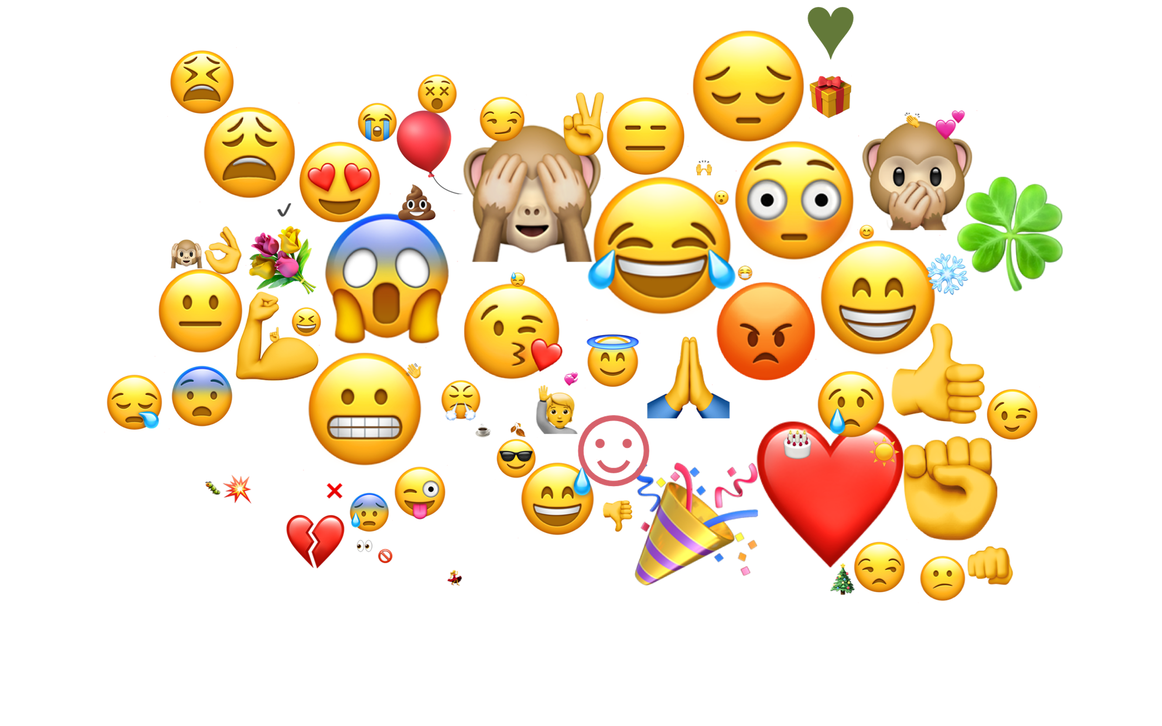
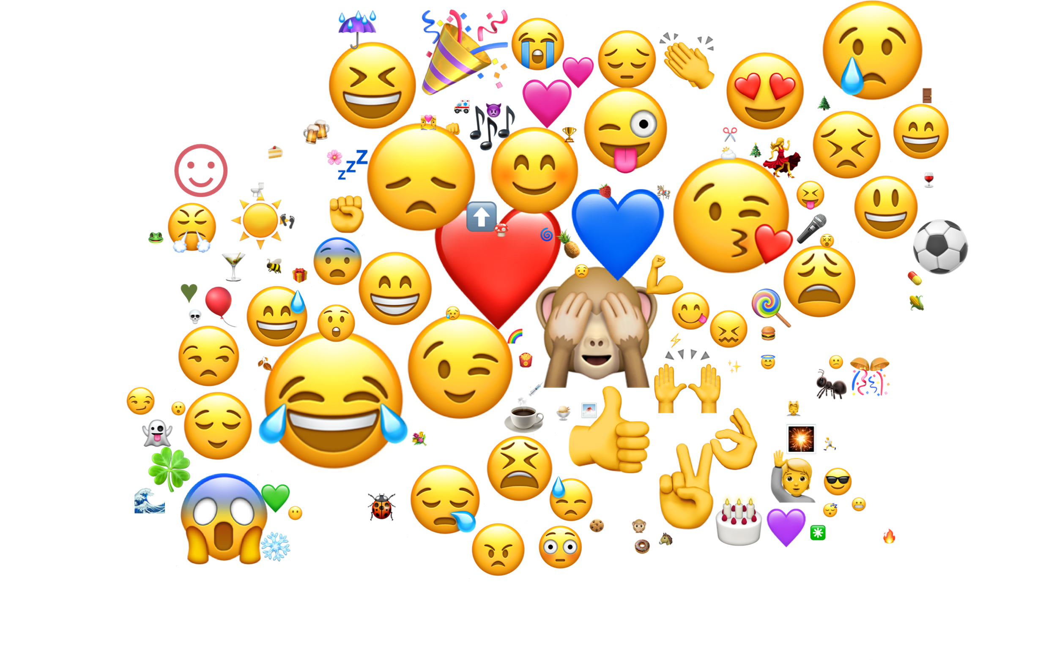
Individual variation in emoji usage

Slide 22
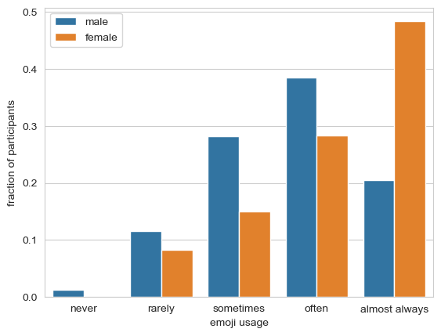
Emoji usage by gender

Slide 23
Personal pronouns
Potsdam Commentary Corpus (German news): 88% third person pronouns
Twitter / blogs:

Slide 24
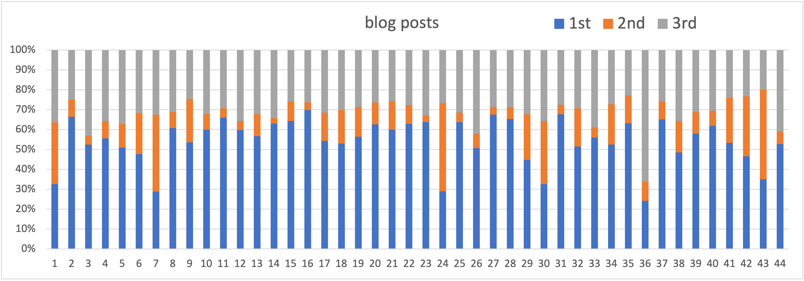
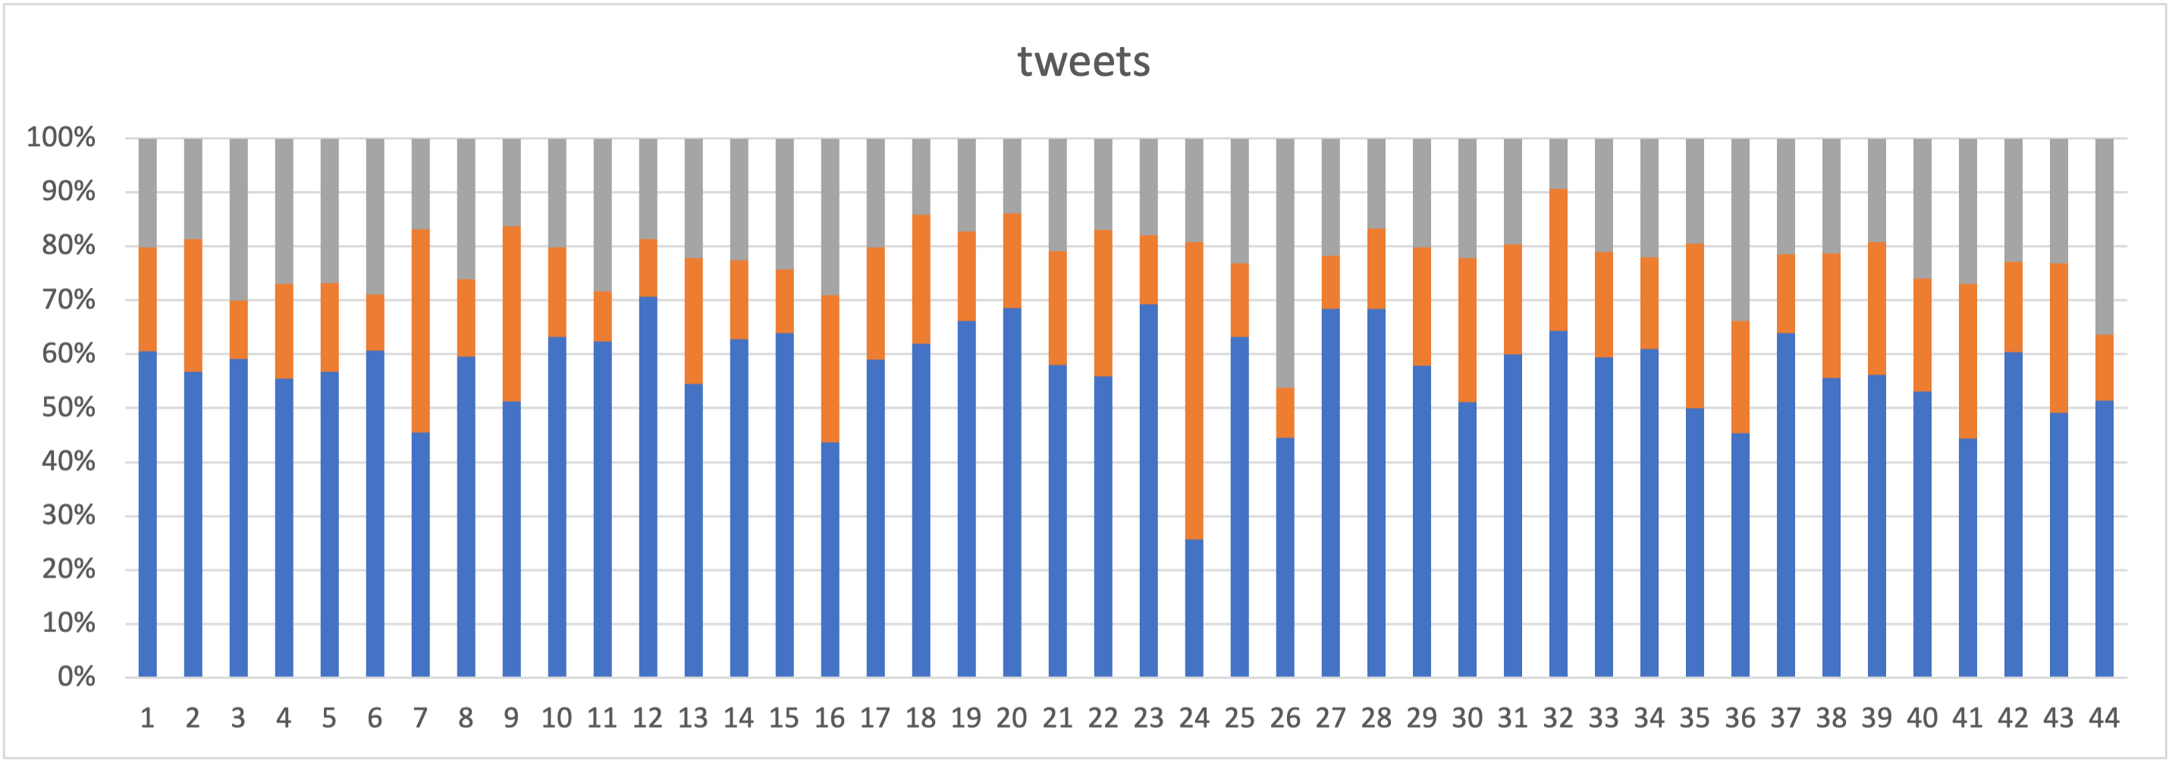
Pronouns

Slide 25
Individual
Topic
Medium
Register
Notes:
Question: Orderly Heterogeneity? Do all people within the corpus behave the same?

Slide 26
Register:
The Medium is not the Message

Slide 27
Bl
Blogs
Tweets
Written
Distant
Close
Spoken
Koch/Österreicher (1985)
Notes:
Social media = informal language in written form
mixed settings, communities
technical constraints
Few studies that specifically compare different channels and fewer that look at individual speakers across channels

Slide 28
CMC and register
Register ≙ situational context of communication (Biber & Conrad 2005)
What influences register? (Biber & Conrad 2019)
Setting and channel of communication
Discourse participants and their relationships
Purpose of communication
Is there a social media register?
Tagliamonte 2016: ‘different CMC registers’, such as instant messaging, texting on phones, and email
Biber & Egbert 2016: ‘new internet registers, such as blogs, Facebook/Twitter posts, and email messages’
…But what about varying use of style in one social medium?
Notes:
Register variation can be observed when the communicative situation changes
Different registers for different communication media

Slide 29
CMC and register
‘Am Dienstag ist Valentinstag ! ❤ An unserem #PinterestSonntag hat [NAME] die herzigsten DIYs für Omas und Tanten ... [URL]’
‘Tuesday is Valentine’s Day ! ❤ For #PinterestSunday , [NAME] wrote about the sweetest DIYs for moms and aunts … [URL]’ [tweets-2191]
‘Jungs schlafen . Gatte ist aus ... Und ihr so ? [URL]’
‘Boys are asleep . Husband is out … What about you all ? [URL]’ [tweets-2191]

Slide 30
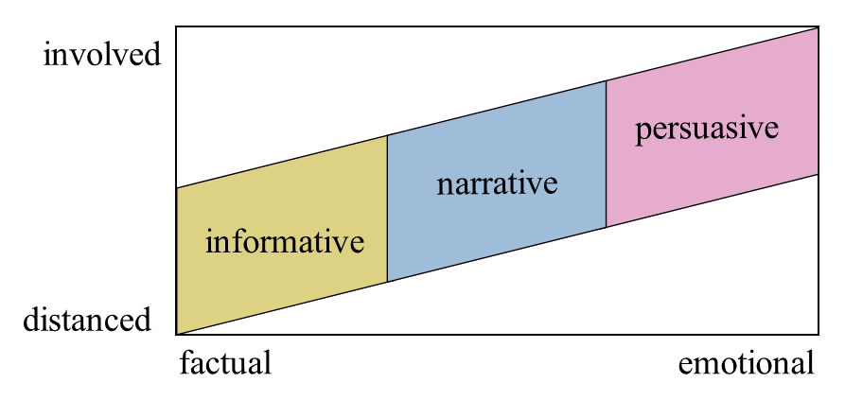
CMC registers
Defining registers based on non-linguistic factors (Biber & Conrad 2019):
Purpose
Topic
Reader involvement
Involvement of author
Identify three registers based on situational parameters

Slide 31
CMC register definitions
 | Informative | Narrative | Persuasive
purpose | Passing on information, showing expertise, drawing attention to a topic, notifications, transfer of knowledge, announcements | Reporting everyday life and experiences, authenticity, relatability, sharing experiences, diary | Influencing readers, activism, politics, change, awareness, positioning, promotion
Involvement of author | Low, rarely says ‘I’ or ‘me’, personal position not expressed | Medium to high, depending of content and aspired level of relatability | High, speaks from own point of view, position visible and distinctly expressed, says ‘I’ or ‘me’, argumentation on a personal level
…

Slide 32
Register annotation
‘Am Dienstag ist Valentinstag ! ❤ An unserem #PinterestSonntag hat [NAME] die herzigsten DIYs für Omas und Tanten ... [URL]’
‘Tuesday is Valentine’s Day ! ❤ For #PinterestSunday , [NAME] wrote about the sweetest DIYs for moms and aunts … [URL]’ [tweets-2191]
‘Jungs schlafen . Gatte ist aus ... Und ihr so ? [URL]’
‘Boys are asleep . Husband is out … What about you all ? [URL]’ [tweets-2191]
👉 informative register
👉 narrative register

Slide 33
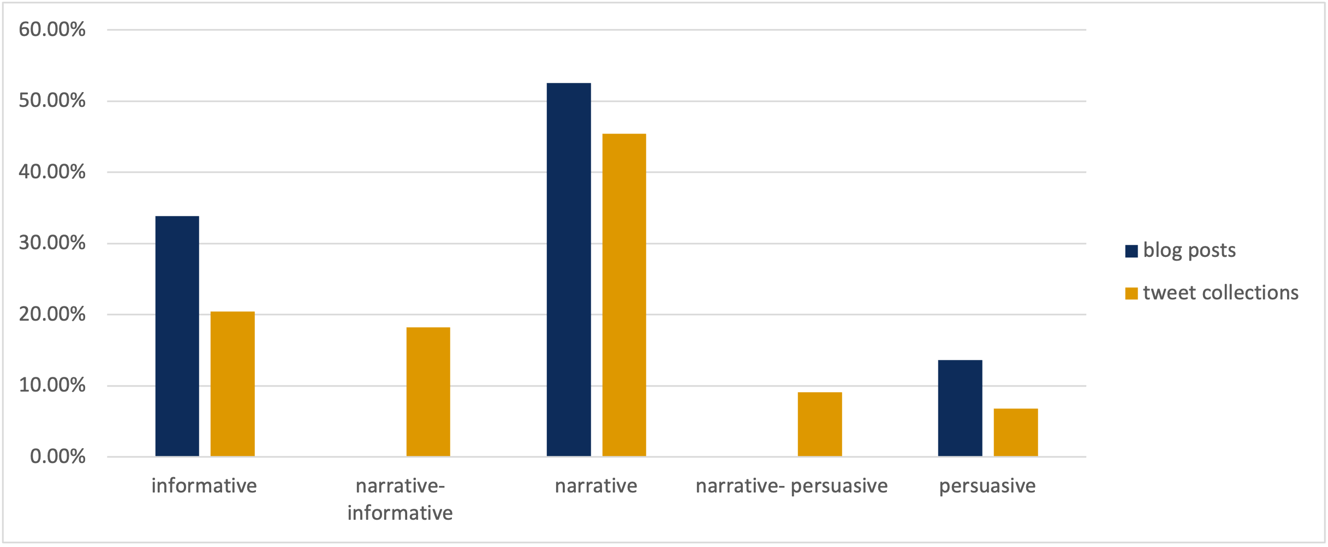
Register in TwiBloCoP
Notes:
Different registers can be found in one medium

Slide 34
CMC register and linguistic phenomena
Analyzed modal and intensifying particles in TwiBloCoP
Cross-reference linguistic features and medium + register
Found that medium and register both (independently) influence the use of these particles
Notes:
Kruskal-Wallis test

Slide 35
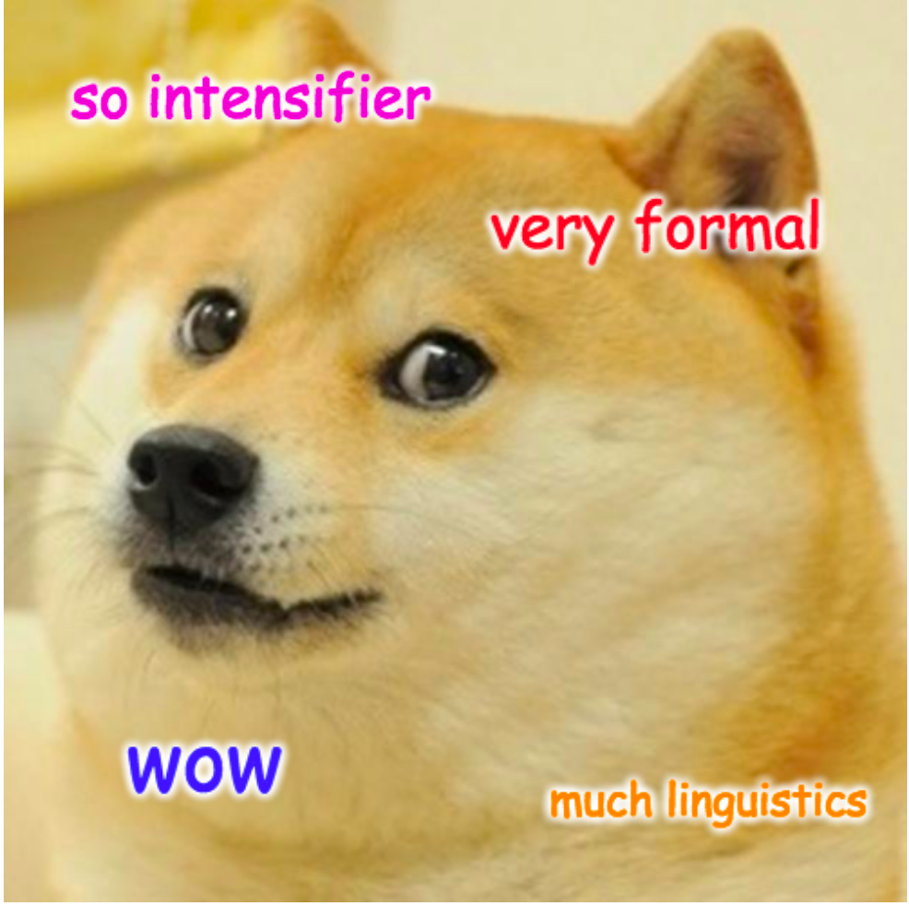
Intensifiers

Slide 36
Intensifiers
Intensifiers “add intensity” to an utterance or property
2 contributions:
Narrow semantic: heightened degree
Not-at-issue: expressive value
37.2% of intensifiable adjective instances in fact have an intensifier in spoken German (Stratton 2020)
Large variability across age groups and individuals

Slide 37
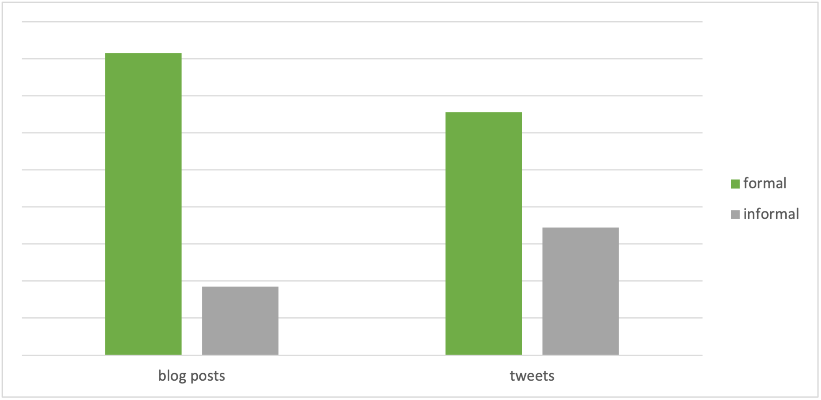
Intensifiers in CMC
Variability of intensifiers has long been reported
Relative frequency of established (‘really, absolutely, very’) and more informal (‘totally, crazy, extremely, …’) intensifiers

Slide 38
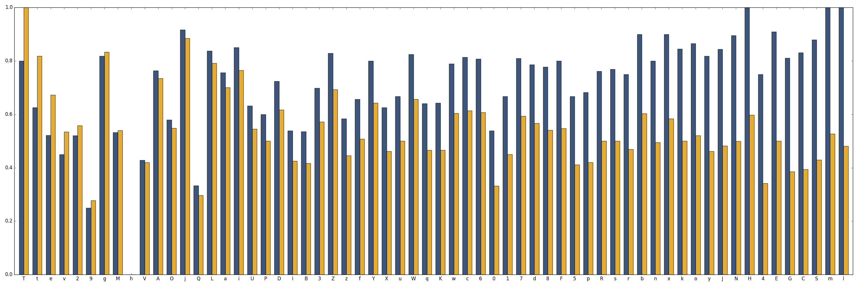
Individual variation in intensifier usage
Percentage of formal intensifiers (wirklich, sehr, absolut = really, very, absolutely)
~ same usage in blogs/tweets
~ more formal in blogs

Slide 39
Manual annotation of intensifiers
Top 5: so, sehr, ganz, gar, wirklich
Most frequent: ‘so’ (occurs 3552 times)

Slide 40
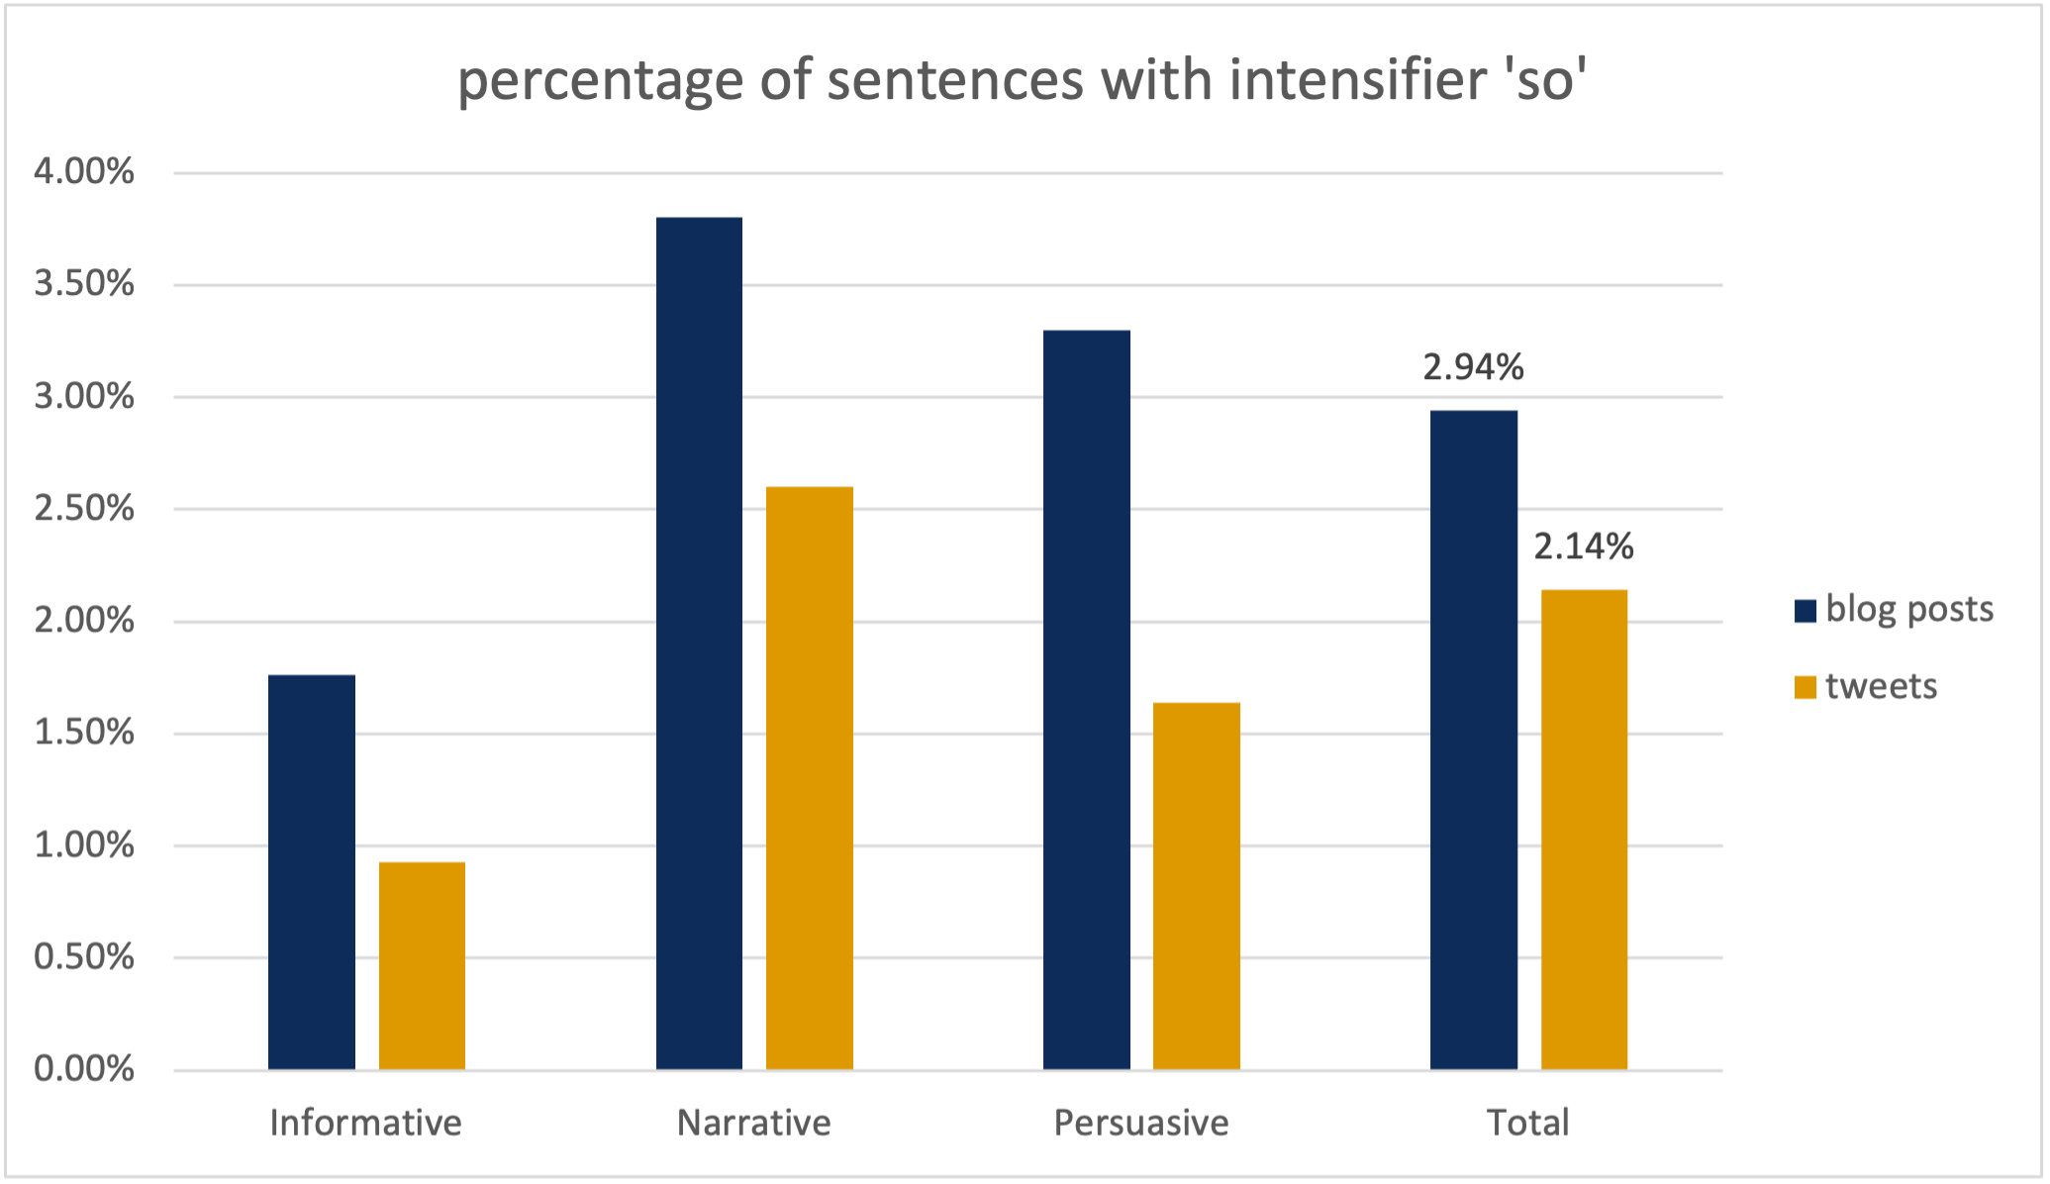
Intensifier usage varies by medium and register
***
***
n.s.

Slide 41
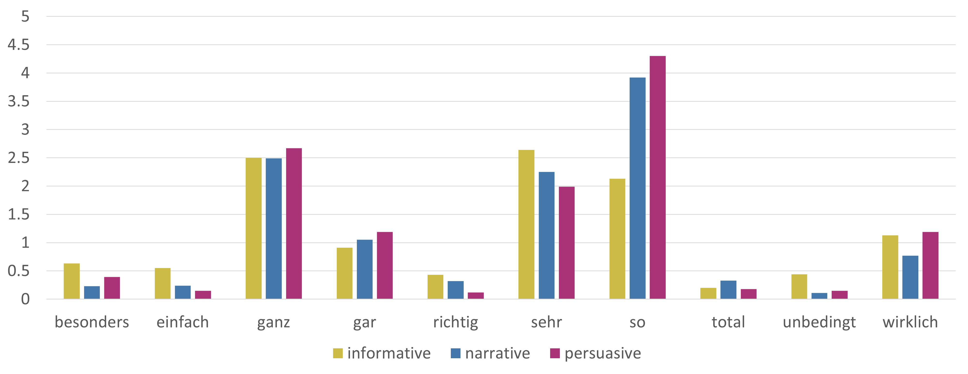
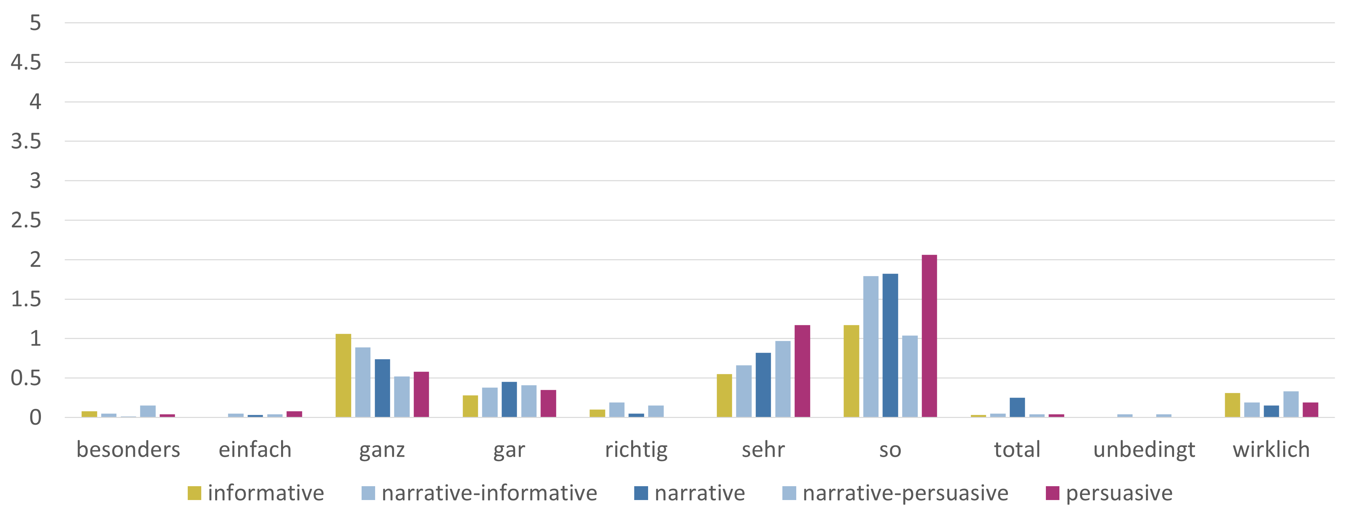
Count of intensifiers by register
blogs
tweets

Slide 42
Clustering the corpus by linguistic features
Which documents are more similar to each other? (Author / Medium / Register)
Agglomerative clustering using scikit-learn package
For each user:
divide documents by medium and register
determine relative frequency of top 10 modal particles and intensifiers
document | vector
b_1095_I | [0, 0, 1.13, 0.38, 0.38, 1.13, 1.5, 0, 0, 0, 0, 0, 0, 0, 0, 0.39, 0.39, 0.78, 0, 0]
b_1095_N | [0, 0, 0, 0, 0, 1.75, 0, 0, 0, 0, 0, 3.57, 0, 0, 1.79, 0, 0, 0, 1.79, 0]
t_1095_I | [0, 0, 1.59, 0, 0, 0, 0, 0, 0, 0, 0, 0, 0, 0, 0, 0, 1.64, 0, 0, 0]

Slide 43
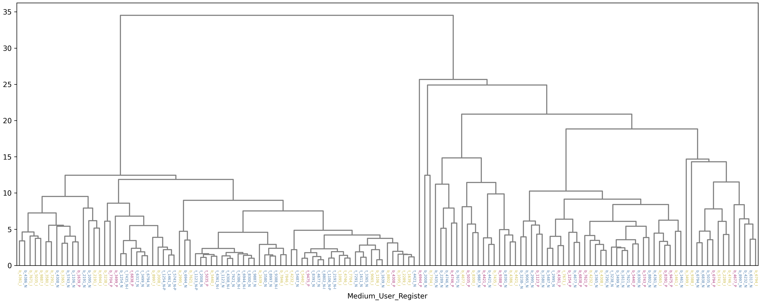
Result of linguistic clustering

Slide 44
Result of linguistic clustering
Are register or social medium clustered more closely?
V-measure (quality of grouping):
Medium V = 0.2246
Register V = 0.0839
Homogeneity of clusters:
Medium: 0.5449
Register: 0.1419
Notes:
V measure = normalized mutual information; average of homogeneity + completeness
Homogeneity = shannon entropy; When all samples in cluster k have the same label c, the homogeneity equals 1.
Completeness = all documents with label k in same cluster

Slide 45
Clustering conclusions
What effects of the used medium and register can be differentiated from individual authors’ variability?
Use of intensifiers differs depending on medium and register
How well does bottom-up clustering based on specific linguistic features capture authors’ usage of different registers and media?
Modal and intensifying particles can be used as feature for clustering
Clustering corresponds more closely to medium distinction

Slide 46
Summary

Slide 47
Individual
Topic
Medium
Register

Slide 48
Individual variation in CMC
No “CMC register”
Must control for topic, medium, register, individual properties of authors
All can have independent effect on linguistic phenomena
Large corpora cause huge effort to
Collect
Preprocess
Annotate
Analyze
Share data
Verification
Sustainability

Slide 49
Bochum CMC Corpora
TwiBloCoP
XXL: eXXtra-Large German Twitter corpus
2014–2023
Majority of German tweets
No topic/keyword based filtering
~ 2 billion tweets
Access: German National Library (soon) or contact me
ChrisTof
PARADISE

Slide 50
Save the Date!
Sustainable Archiving, Indexing, and Distribution of Dynamic Data from Social Media – Twitter and Beyond.
German National Library, Frankfurt
Conference: March 19–20, 2024
Data Sprint: March 21–22, 2024
More Info, Call for Abstracts, Registration:
https://www.dnb.de/twittertagung

Slide 51
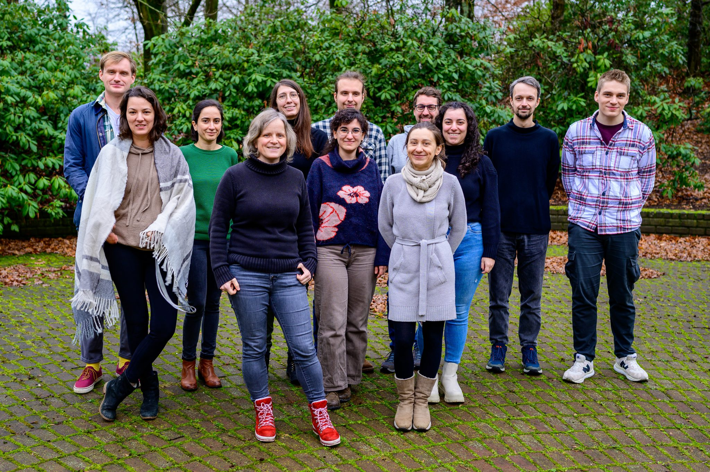



THANK YOU!
Tatjana Scheffler
tatjana.scheffler@rub.de

Slide 52
Image references:
Title: Lewis Ogden, https://www.flickr.com/photos/bitsfrombytes/43617178595
text by Alice Design from Noun Project (CC BY 3.0)
Cat by lizbeth from Noun Project (CC BY 3.0)
kids by Vectorstall from Noun Project (CC BY 3.0)
Car by Rainbow Designs from Noun Project (CC BY 3.0)
User, social media, shirt, tee shirt: freepik via Flaticon.com
Selected paper references:
Tatjana Scheffler, Hannah Seemann, Lesley-Ann Kern. The medium is not the message: Individual level register variation in blogs vs. tweets. Register Studies 4(2). 2022. https://doi.org/10.1075/rs.22009.sch
Tatjana Scheffler, Lesley-Ann Kern and Hannah Seemann. Individuelle linguistische Variabilität in sozialen Medien. In: M. Kupietz/T. Schmidt (eds.), Neue Entwicklungen in der Korpuslandschaft der Germanistik: Beiträge zur IDS-Methodenmesse 2022. (= Korpuslinguistik und interdisziplinäre Perspektiven auf Sprache (CLIP) 11). Tübingen: Narr. 2023.
Hannah Seemann and Tatjana Scheffler. Differentiating Social Media Texts via Clustering. In: Proceedings of the CHR Conference 2022, pp. 177–188. 2022. https://ceur-ws.org/Vol-3290/short_paper5903.pdf
Tatjana Scheffler, Michael Richter, Roland van Hout. Tracing and classifying German intensifiers via information theory. Language Sciences 96. 2023. https://doi.org/10.1016/j.langsci.2022.101535 Repository location: https://osf.io/69x8b/

Slide 53
XXL German Twitter corpus
Twitter stream
XXL: eXXtra-Large German Twitter corpus
Method: (Scheffler 2014); 24 million German tweets from April 2013
No topic/keyword based filtering
Mid 2014 – March 2023
~ 2 billion tweets in total
Access: German National Library (soon) or contact me
German
stop word list
tracking keywords
LangId
language filter
German Twitter corpus

Slide 54
CMC register definitions
 | Informative | Narrative | Persuasive
topics | Milestones in personal life, competitions, reviews, recipes, nutrition, crafting | Everyday life, holidays, career, health, nutrition, personal life | Parenting, nutrition, product placement, politics, gender, education, sustainability
Interactivity, reader involvement | Low, rarely addresses reader, no engagement, no call to action, no reaction needed / expected | Optional, can be medium to high, depending on format/level of community | High, expected, might be provocative, direct address, high level of emotionalization

